Slide 1
DBMS Basic Concepts

Slide 2
DBMS
Database Management System
Term Database requires understanding of
data and information
Data: It can be anything like name, place or number, etc. Data usually refers to raw data, or unprocessed data.
Information: It is organized or classified data so that it has some meaningful values to the receiver.
  Information is the processed data on which decisions and actions are based.

Slide 3


Slide 4
Difference between Data and Information?

Slide 5
Data | Information
Data is raw facts and figures | Information is a processed form of data
For example: 12 is data | For example: When 12 is stored in row column form as shown it is information. Age 12
Data are atomic level pieces of information | Information is a collection of data
Data does not help in decision making | Information helps in decision making

Slide 6
Database
A database is a collection of logically related data that is designed to meet the information needs of an organization
The related information when placed is an organized form makes a database.
The organization of data/information is necessary because unorganized information has no meaning.

Slide 7
Purpose of DBMS
An example
University Database:
Data about students, faculty, courses, research-laboratories, course registration/enrollment etc. Reflects the state of affairs of the academic aspects of the university.
Purpose: To keep an accurate track of the academic activities of the university.

Slide 8
Purpose of DBMS
Before DBMSs were introduced, organizations usually stored information in file processing system which has a number of disadvantages:
Data redundancy and inconsistency
Difficulty in accessing data
Data isolation
Integrity problems
Atomicity problems
Concurrent-access anomalies
Security problems

Slide 9
Database Management System
DBMS A database management system is the software system that allows users to define, create and maintain a database and provides controlled access to the data.
A database management system (DBMS) is basically a collection of programs that enables users to store, modify, and extract information from a database as per the requirements.

Slide 10
Operations on databases
To add new information
To view or retrieve the stored information
To modify or edit the existing information
To remove or delete the unwanted information
Arranging the information in a desired order etc.

Slide 11
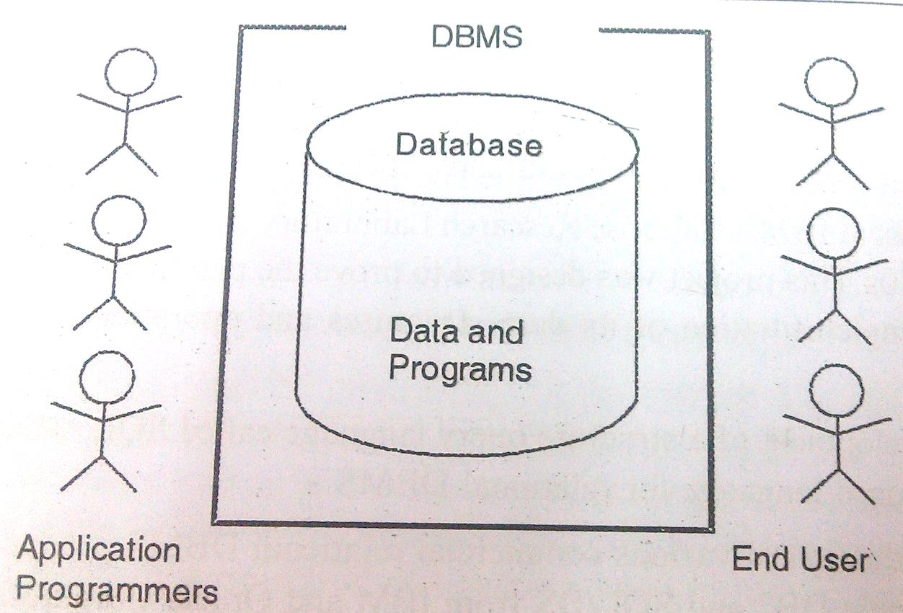
Components of Database
Five major components in database system environment:
  Hardware
  Software
  Data
  Users
  Procedures

Slide 12
Components of Database System
Hardware: It is the actual computer system used for keeping and accessing the database. DBMS hardware consists of secondary storage devices like hard disks.
Software: It is the actual DBMS. Between the physical database itself and the users of system .
This is the program which controls everything. The DBMS software is more like a wrapper around the physical database, which provides us with an easy-to-use interface to store, access and update data.

Slide 13
Components of Database System
Users: There are number of users who can access or retrieve data on demand using the applications and the interfaces provided by DBMS. The users can be:
  Data base Administrator ( DBA)
  Application Programmers
  End Users: These are divided into:
  Casual End User
  Naïve End User
  Sophisticated user

Slide 14
Components of Database System
Procedures: It refers to the instructions and rules that govern the design and the use of the database. The users of the system and the staff that manage the database requires documented procedures on how to use or run the system.
Data: It is that resource, for which DBMS was designed. The motive behind the creation of DBMS was to store and utilize data.
In a typical Database, the user saved Data is present and meta data is stored.

Slide 15
Applications of DBMS
Banking: all transactions
Airlines: reservations, schedules
Universities: registration, grades
Sales: customers, products, purchases
Online retailers: order tracking, customized recommendations
Manufacturing: production, inventory, orders, supply chain
Human resources: employee records, salaries, tax deductions

Slide 16
Data models, Schemas, and Instances
Data model:-A set of concepts to describe the structure of a database, and certain constraints that the database should obey.
Schema:- The overall description of the database is called the Database Schema.
  A schema is defined as an outline or a plan that describes the records and relationships existing at the particular level.
  Instance:- Data in the database at a particular moment in time.

Slide 17
Database Architecture

Slide 18
DBMS Architecture
DBMS architecture helps in design, development, implementation and maintenance of the database.
The design of a DBMS depends on its architecture. It can be
  Centralized
  Decentralized
  Hierarchical.

Slide 19
DBMS Architecture
The architecture of a DBMS be either single tier or multi-tier.
Selecting the correct database architecture helps in quick and secure access to this data.
The tiers are classified as follows :
  1-tier
  2-tier
  3-tier

Slide 20
1-tier or Single-tier Architecture
The simplest of database architecture is 1 tier where the Client, Server, and Database all reside on the same machine.
But such architecture is rarely used in production.

Slide 21

Two-tier and three-tier architecture

Slide 22
Two-tier architecture
Client machine 1
Client machine 1
Client machine 1
Database Server

Slide 23
Three-tier architecture
User
Client Application
Client machine 1
Client machine 1
Client machine 1
Application or Client Layer
Business Layer
Application Server
Database Server
Database Server
Data Server
Data Layer

Slide 24

When you install a DB in your system and access it to practice SQL queries is which type of architecture?

Slide 25
Answer:
1-Tier Architecture
A simple one tier architecture example would be anytime you install a Database in your system and access it to practice SQL queries. But such architecture is rarely used in production.

Slide 26
When you book train ticket online follows which type of architecture?

Slide 27
Schema
It is logical representation of database. Or
Overall design of the database is called a schema
Data is logically represented in the form of tables.
Example: Design schema of entity ‘student’.
In hard disk data is not stored in the form of Reg. number, name etc..
In DBMS, when data will be accessed, it will be accessed in the form of tables.
Reg. Number | Name | Age | Address

Slide 28
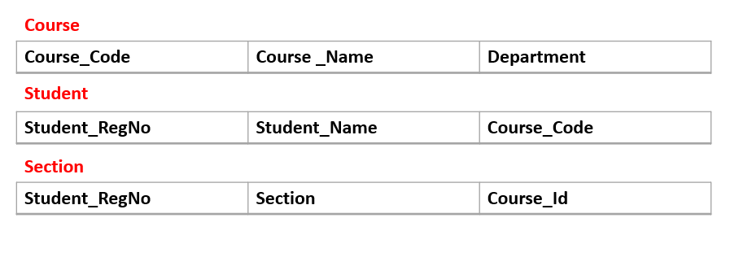
Schema
The term database schema can refer to a visual representation of a database, a set of rules that govern a database.
Rules and constraints to define the database
A database schema is a sketch of a planned database. It doesn’t have any data in it.
Important Point

Slide 29
Instance
When schema is filled with data items it is termed as instance of schema.
Data in the database at a particular moment of time is called database state or snapshot, instance.
Reg. Number | Name | Age | Address
1234 | ABC | 12 | xyzzy

Slide 30

Three level schema architecture
This gives rise to a term called Data Independence

Slide 31
Objective of 3 level architecture:
is to separate each user’s view of database from the way the database is physically represented.
Reason:
Each user may be need to see data as per need
Users need not to directly deal with physical database storage details
DBA should be able to change DA storage structures without changing the user’s view

Slide 32
External or View level: It is the users’ view of the database. This level describes that part of the database that is relevant to each user.
  For example, one user may view dates in the form (day, month, year), while another may view dates as (year, month, day).

Slide 33
Conceptual or logical level: It is the community view of the database. This level describes what data is stored in the database and the relationships among the data.
It represents:
  All entities, their attributes, and their relationships;
  The constraints on the data;
  Security and integrity information.

Slide 34
Physical Schema (Internal or storage level)
It is the physical representation of the database on the computer. This level describes how the data is stored in the database.

Slide 35
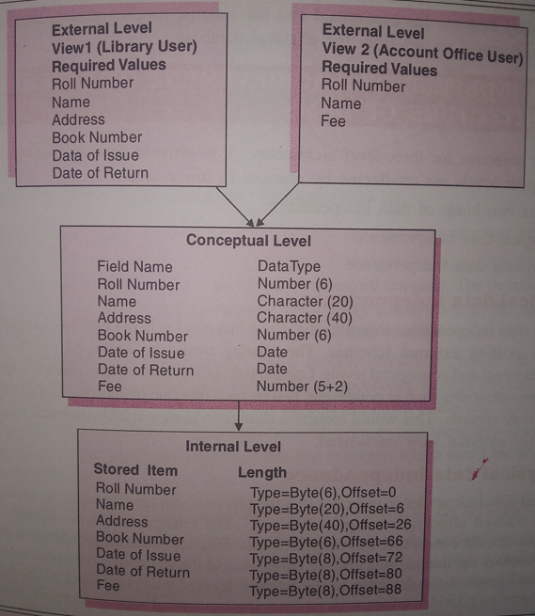
3 level schema architecture

Slide 36
Data Independence or Data Abstraction
A major purpose of database system is to provide user with an abstract view of data.
That is, system hides certain details of how the data are stored and maintained.

Slide 37

View of Data
An architecture for a database system

Slide 38
Levels of Abstraction(view of data)
View level: describe only part of database.
Application programs hide details of data types.
Complexity remain due to variety of information stored.
Views can also hide information (such as an employee’s salary) for security purposes.

Slide 39
Levels of Abstraction(view of data)
Logical level: describes what data stored in database, and the relationships among the data.
Database Designers, who decides what information to keep in the database, use the logical level of abstraction.
Physical level: describes how a record (e.g., customer) is stored.
DBA use this view.

Slide 40
Data Independence-Achievement of Layered Architecture of DBMS
Two kinds of data independence:
  Logical data independence
  Physical data independence

Slide 41
Data Independence
Logical Data Independence: The capacity to change the conceptual schema without having to change the external schemas and their application programs.
Physical Data Independence: The capacity to change the internal schema without having to change the conceptual schema.

Slide 42
3 level schema architecture

Slide 43
Mapping between Views
The processes of transforming requests and results between the levels are called mappings.
When a schema at a lower level is changed, only the mappings between this schema and higher-level schemas need to be changed in a DBMS.
The higher-level schemas themselves are unchanged. Hence, the application programs need not be changed since they refer to the external schemas.

Slide 44
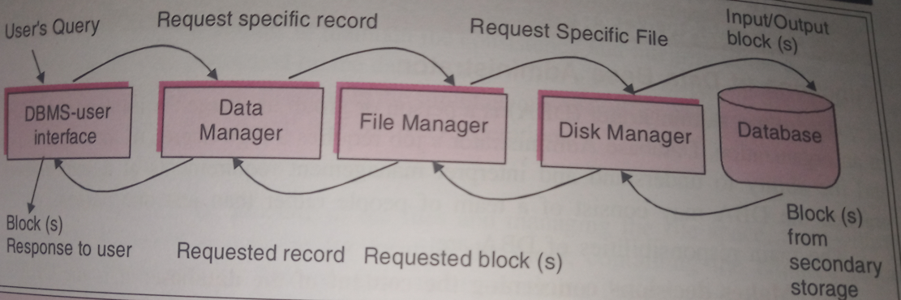
Procedure for Database Access

Slide 45
MCQ

Slide 46
Database Languages
Database languages are used to create and maintain database on computer.
Data Definition Language(DDL): It is a language that allows user to define data and their relationship to other types of data.
  CREATE
  ALTER
  DROP
  TRUNCATE
  RENAME

Slide 47
Database Languages
Data Manipulation Language(DML):It provides a set of operations to support the basic data manipulation operations on the data held in databases. It allows user to insert, update, delete and retrieve data from the database.
  DELETE
  INSERT
  SELECT
  UPDATE

Slide 48
Database Languages
Data Control Language(DCL): DCL statements control access to data and the database
  GRANT
  REVOKE
  COMMENT

Slide 49
Database Languages
Transaction Control Language(TCL): TCL statements manage the change made by DML statements, and group DML statements into transactions
  COMMIT
  ROLLBACK
  SAVEPOINT
  SET TRANSACTION

Slide 50
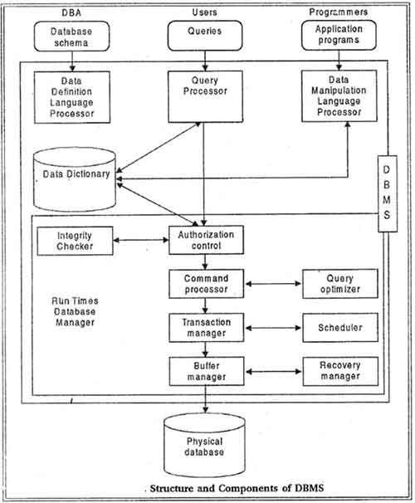
Structure and Component of DMBS

